Slide 1



DATA STRUCTURES AND ITS APPLICATIONS
Graphs
Sandesh B. J & Saritha
Department of Computer Science & Engineering

Slide 2


DATA STRUCTURES AND ITS APPLICATIONS
Graphs
Saritha
Department of Computer Science & Engineering

Slide 3
DATA STRUCTURES AND ITS APPLICATIONS
Introduction to graphs
Linear data structures
Array
0
1
2
3
4
Stack
Queue
Linked List
10
20
30
N

Slide 4

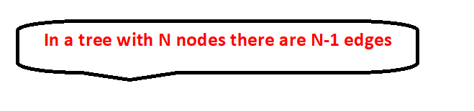
DATA STRUCTURES AND ITS APPLICATIONS
Introduction to Graphs
Non-Linear Data Structure
Graph
Tree

Slide 5
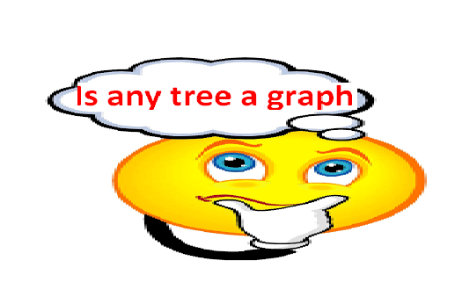

DATA STRUCTURES AND ITS APPLICATIONS
Introduction to graph

Slide 6
DATA STRUCTURES AND ITS APPLICATIONS
Graphs
A Graph is a data structure that consists of set of vertices and a set of edges that relate the node to each other.
The set of edges represents the relationship among the vertices.
A graph G is defined as
G=(V,E)
V: finite nonempty set of vertices
E: a set of edges
V = { v1,v2,v3,v4,v5,v6,v7,v8}
v1
v2
v6
v3
v5
v4
v7
v8

Slide 7
DATA STRUCTURES AND ITS APPLICATIONS
Representation of Edge
v1
v2
V = { v1,v2,v3,v4,v5,v6,v7,v8}
E={(v1,v2),(v2,v3),(v2,v4),(v4,v8),(v1,v5),(v1,v6),
(v6,v7),(v5,v8)}
v6
v4
v5
v3
v7
v8

Slide 8
DATA STRUCTURES AND ITS APPLICATIONS
Types of Graphs
Undirected Graph:
  A graph is undirected, when the pair of vertices representing any edge is unordered.
Directed Graph:
  A graph with all directed edges is called diagraph or directed graph.
u
v
u
v

Slide 9
DATA STRUCTURES AND ITS APPLICATIONS
Types of Graphs
Weighted Graph:
A weighted graph is a graph where each edge has a numerical value called weight.
1
1
2
3
4
0
2
7
3
8
5
4

Slide 10
DATA STRUCTURES AND ITS APPLICATIONS
Graph terminologies
Adjacent Nodes :
A node n is adjacent to node m if there is an edge from m to n.
if n is adjacent to m, then n is called the successor of m and m
is called the predecessor of n.
For example : a is adjacent to b
Path:
Path is a sequence of vertices that connect two nodes in a graph.
a
b

Slide 11
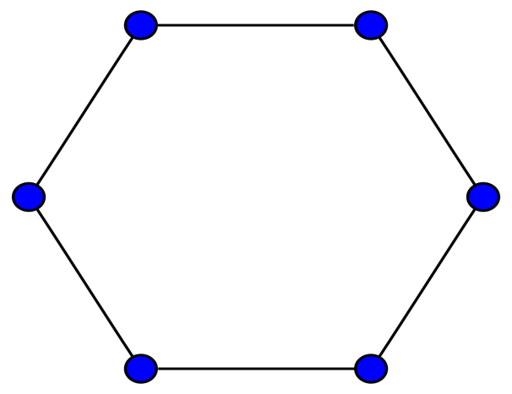
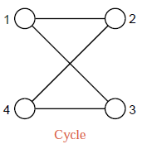
DATA STRUCTURES AND ITS APPLICATIONS
Graph terminologies
Cycle :
A path from node to itself is called a cycle or cycle is path in which first and last vertices are same. A graph with at-least one cycle is called cyclic graph. For example the below graph are cyclic graphs

Slide 12
DATA STRUCTURES AND ITS APPLICATIONS
Graph terminologies
Acylic :
A graph with no cycles is called acyclic graph. A directed acyclic graph is called dag. For example below graph is a directed acylic graph
3
1
2
4

Slide 13
DATA STRUCTURES AND ITS APPLICATIONS
Graph terminologies
Incident:
A node n is incident to an edge x, if node is one of the two nodes the edge connects.
Degree:
The degree of vertex i is the number of edges incident on vertex i.
A
D
B
C
degree(A)=2,degree of(D)=1

Slide 14
DATA STRUCTURES AND ITS APPLICATIONS
Graph terminologies
In-degree:
In-degree of vertex i is the number of edges incident to i.
Out-degree:
Out-degree of vertex i is the number of edges incident from i.
A
D
B
C
Out-degree(A)=2,in-degree of(A)=0
Out-degree(c)=1,in-degree of (c)=1

Slide 15
DATA STRUCTURES AND ITS APPLICATIONS
Properties of Graph
Directed graph:
The number of possible pairs in an m vertex graph is m*(m-1)
The number of edges in an directed graph is m*(m-1) since the edge(u, v) is not the same as the edge(v, u)
The number of edges in an directed graph is<=m*(m-1)

Slide 16
DATA STRUCTURES AND ITS APPLICATIONS
Properties of Graph
Undirected graph:
The number of possible pairs in an m vertex graph is m*(m-1)
The number of edges in an undirected graph is m*(m-1)/2 since the edge(u, v) is same as the edge(v, u)
A
D
F
E
B
C

Slide 17
DATA STRUCTURES AND ITS APPLICATIONS
Applications of graph
Social Networking sites
Sita
Geeta
Hari
Ram
Navin
Ryan
Amir
Shyam
Swati
Veer

Slide 18

THANK YOU
Saritha
Department of Computer Science & Engineering
Saritha.k@pes.edu
9844668963

